Slide 1
ASP.NET MVC
Lesson 7 Scaffolding

Slide 2
Scaffolding
Generating CRUD Controller & views
Details
Index
Edit (GET & POST)
Create (GET & POST)
Delete (GET & POST)
Relational data

Slide 3
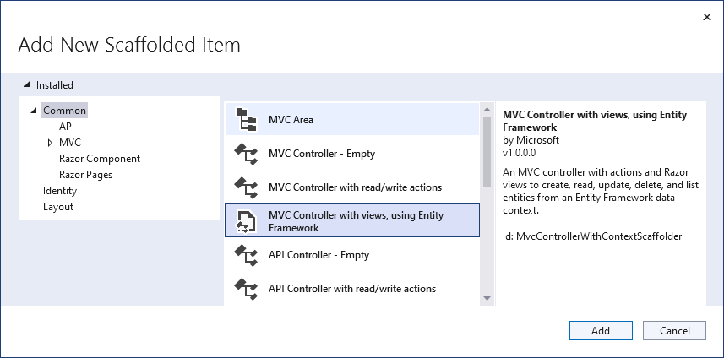
scaffolding
Generating a CRUD Controller & Views using a Model Class
Controllers | Add | New Scaffolded Item
Add

Slide 4
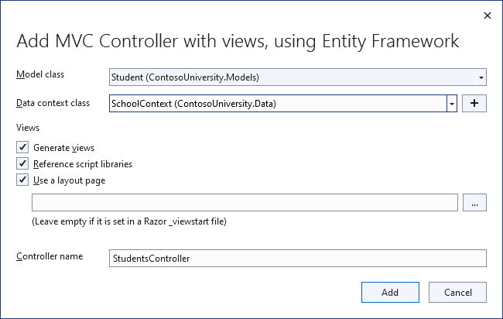
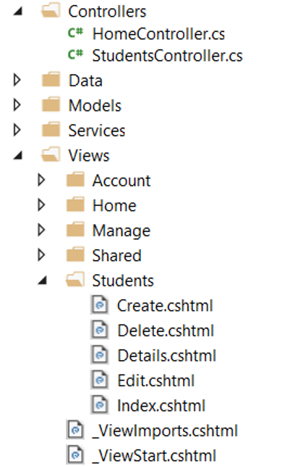
Student CRUD

Slide 5
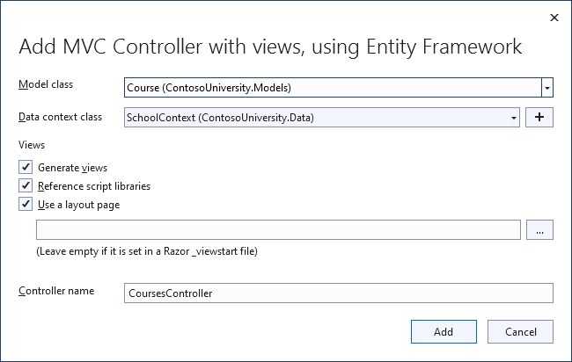
Course & Enrollment CRUD

Slide 6
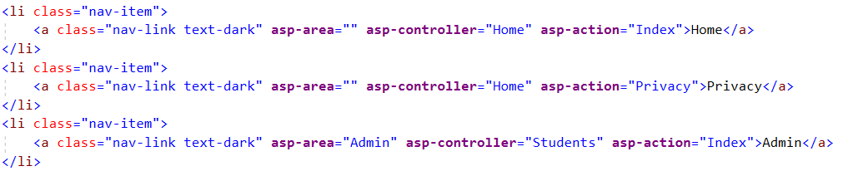
Admin-Page
No Maintain Controller, instead go directly to page to manage Students

Slide 7
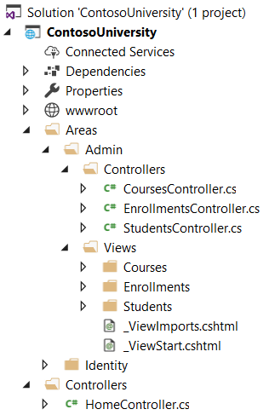
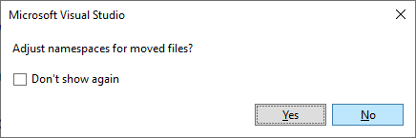
Administrator Area
Move controllers to Admin/Controllers folder
Move view folders to Admin/Views folder
Delete Maintain Controller and Views/Maintain folder

Slide 8
Add Authorization and Admin-Area
StudentsController.cs, EnrollmentsController.cs en CoursesController.cs
namespace ContosoUniversity.Controllers
{
[Area("Admin")]
[Authorize(Roles = "Administrator")]
public class StudentsController : Controller
{
private readonly SchoolContext _context;
public StudentsController(SchoolContext context)
{
_context = context;
}

Slide 9
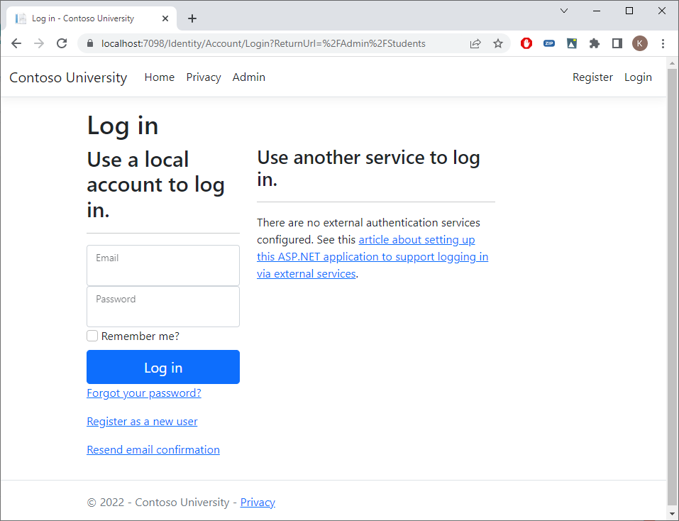
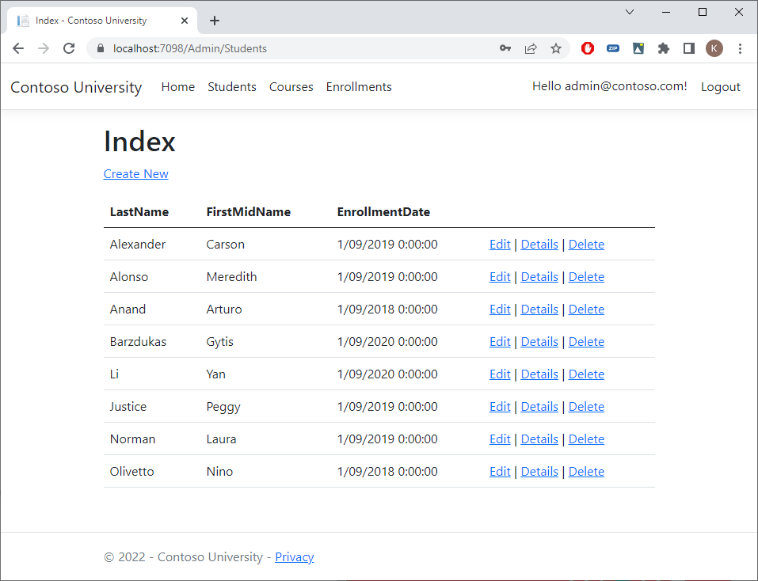
Run The Application

Slide 10
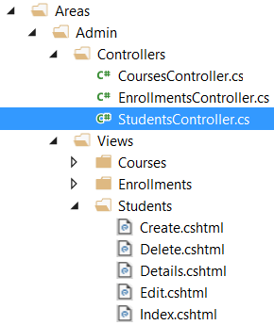
generated code
StudentsController.cs & Students Views
Details: show the data of one student (Get)
Index: list all students (Get)
Edit
Get: retrieve student data to be modified in the form
Post: write modified student to the database
Create
Get: show form to input new student
Post: add new student to the database
Delete - DeleteConfirmed
Get: ask confirmation
Post: delete student

Slide 11
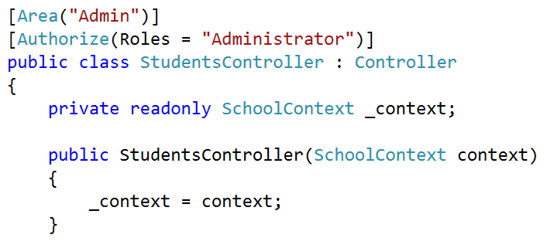
SchoolContext

Slide 12
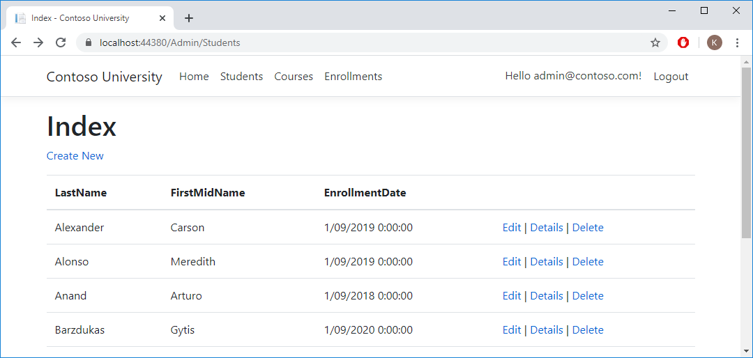
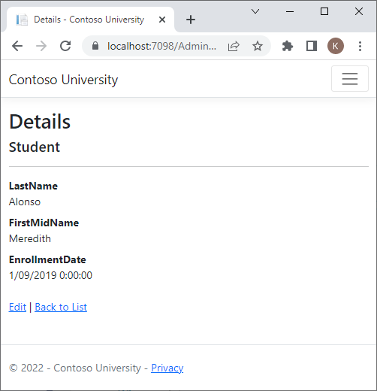
1. Details method
Students/Details/2

Slide 13
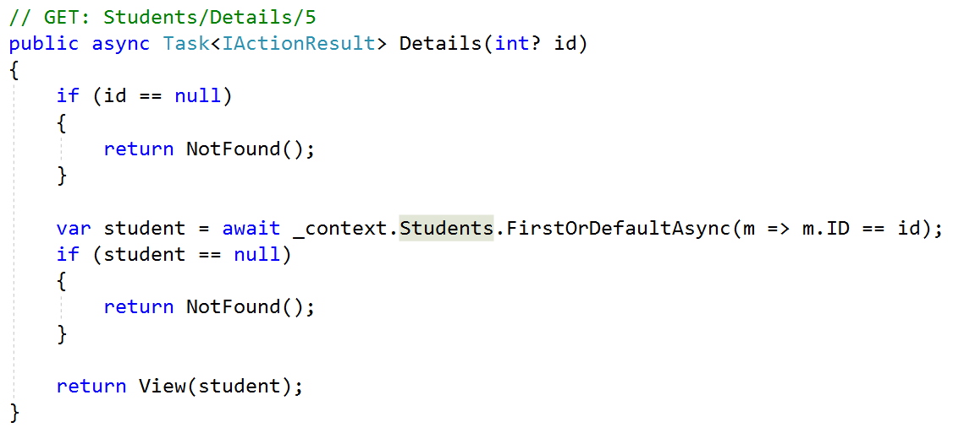
Details method

Slide 14
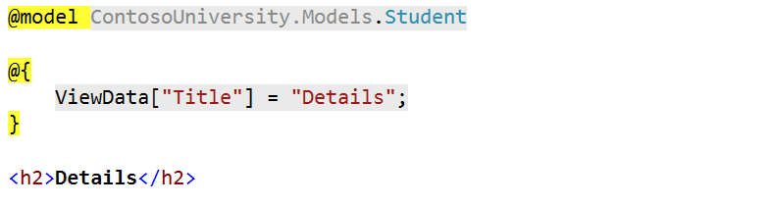
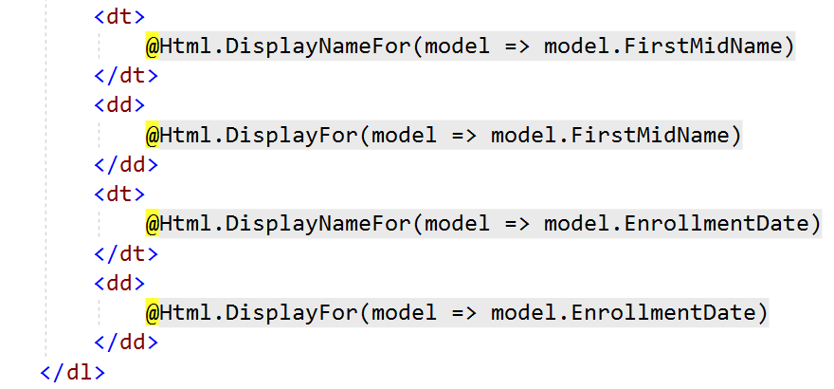
Details view

Slide 15
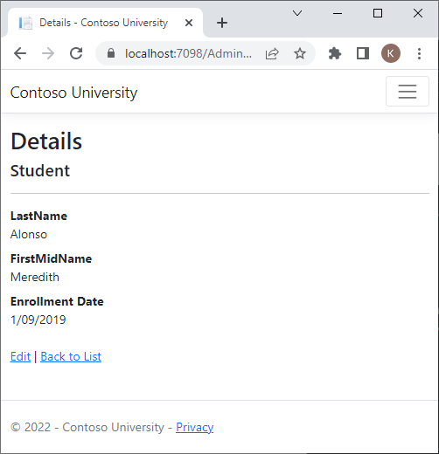
Data Annotations
public class Student
{
public int ID { get; set; }
public string LastName { get; set; }
public string FirstMidName { get; set; }
[Display(Name = "Enrollment Date")]
[DataType(DataType.Date)]
public DateTime EnrollmentDate { get; set; }
public ICollection<Enrollment>? Enrollments { get; set; }
}

Slide 16
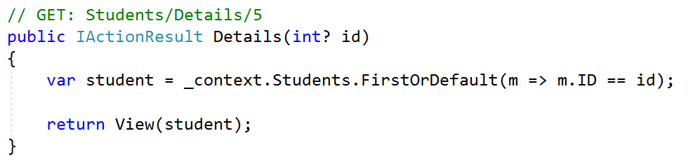
Details (Part 1 ⇨ Synchronous)
Build view
start
end
Waiting for I/O
1 thread
DB request
Request complete
time

Slide 17
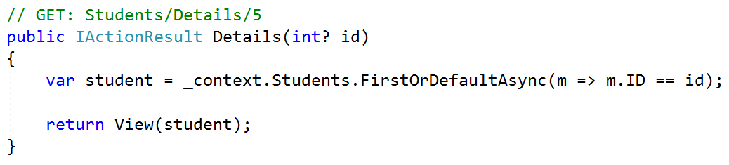
Details (Part 2 ⇨ Asynchronous)
Is this right?

Slide 18
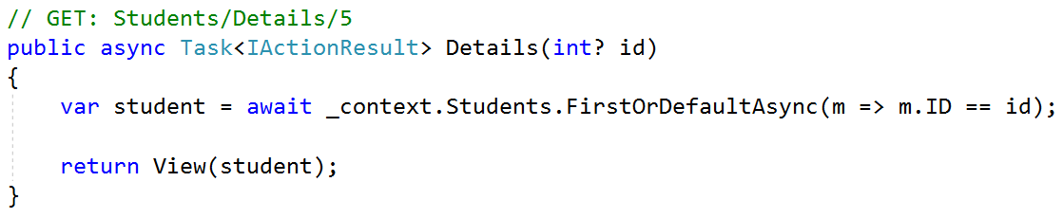
Details (Async, await, Task)
Is there a performance gain?

Slide 19
synchronous ⬄ ASynchronous
Build view
start
end
Synchronous (1 thread)
Waiting for I/O
DB request
Request complete
time
Build view
start
end
Asynchronous (2 threads)
Waiting for I/O
DB request (async)
Request complete
(await)
time

Slide 20
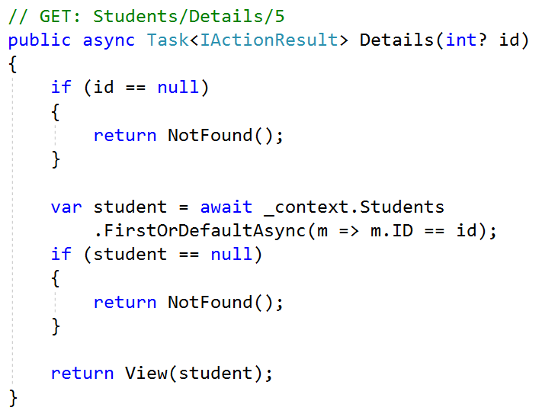
Async, await, Task

Slide 21
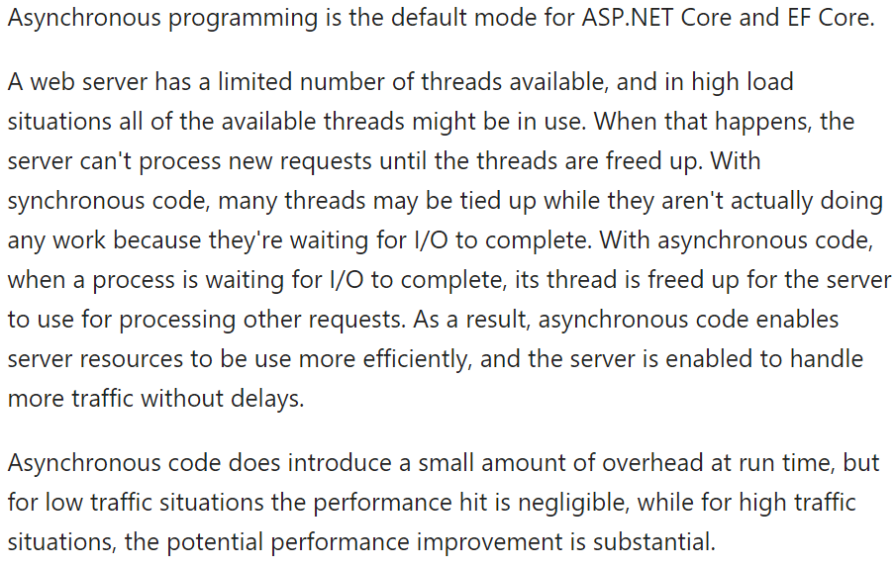
Asynchronous code

Slide 22
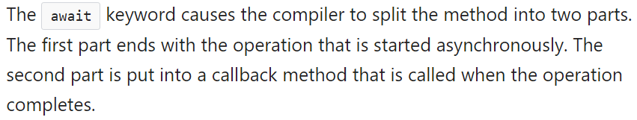
Await

Slide 23
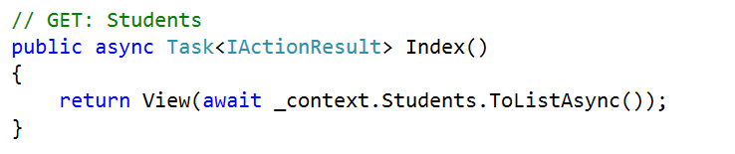
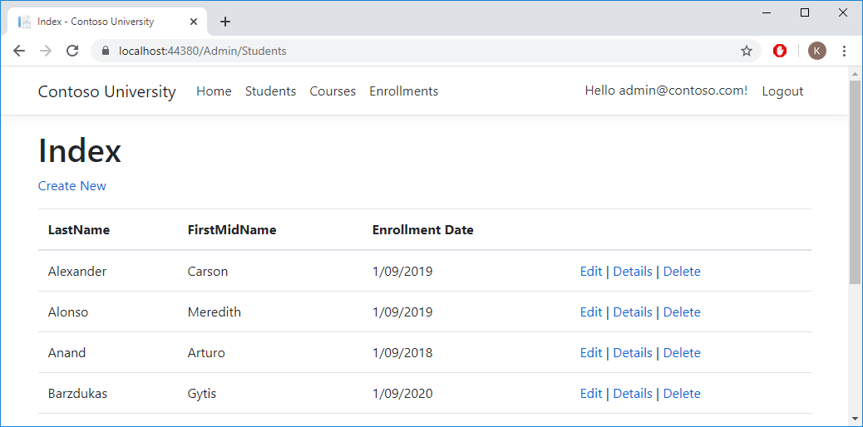
2. Index Method

Slide 24
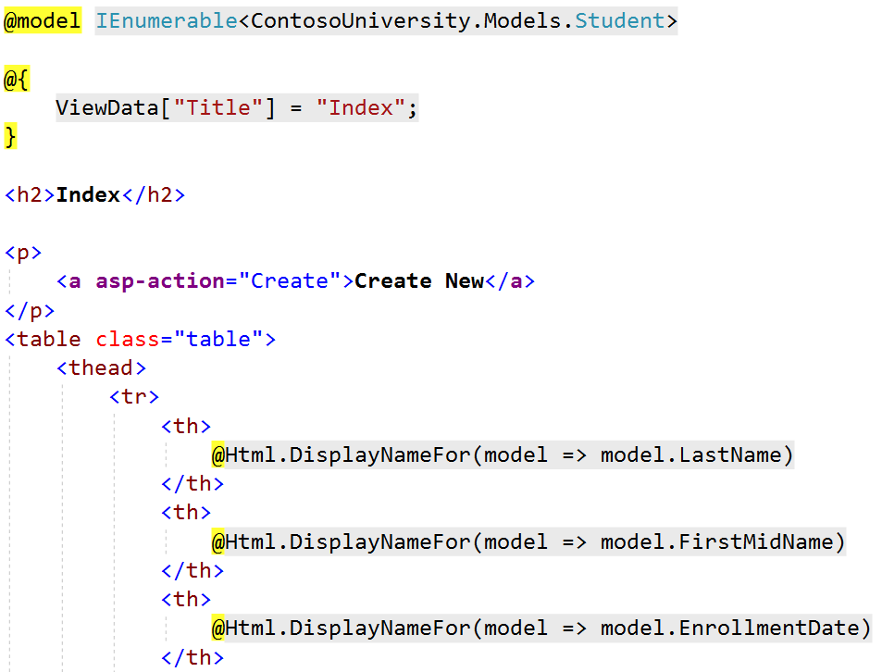
Index View

Slide 25
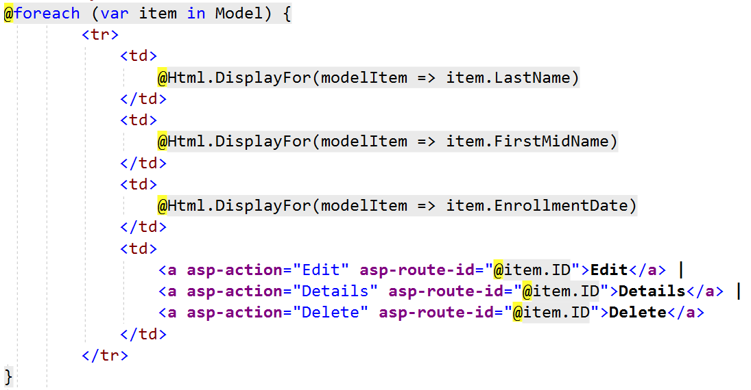
Index View

Slide 26
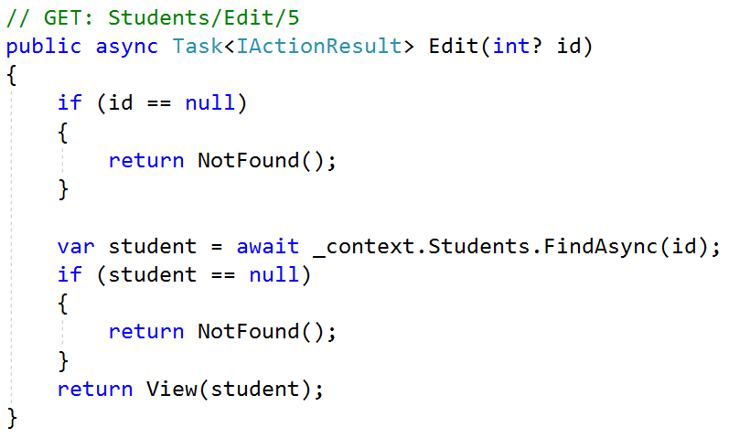
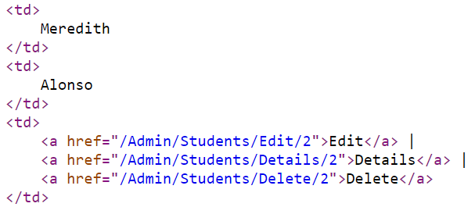
3A. Edit method (Get)

Slide 27
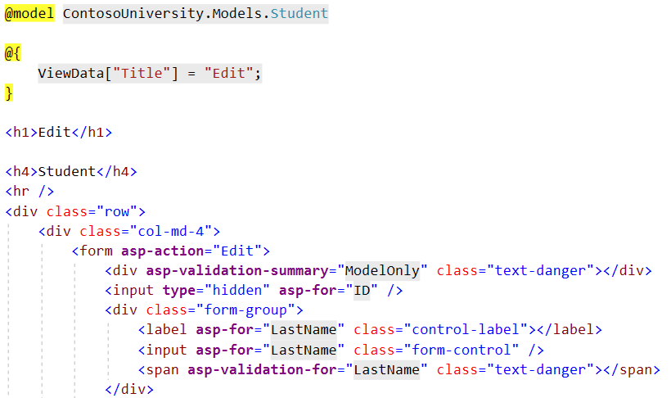
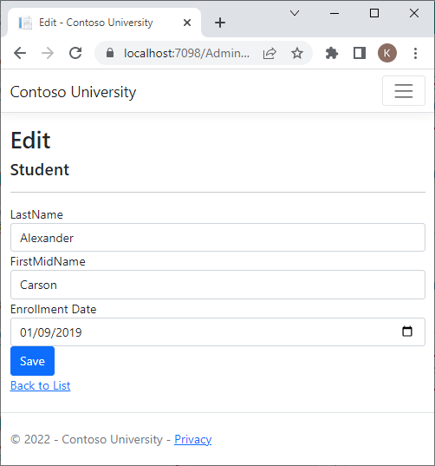
Edit View

Slide 28
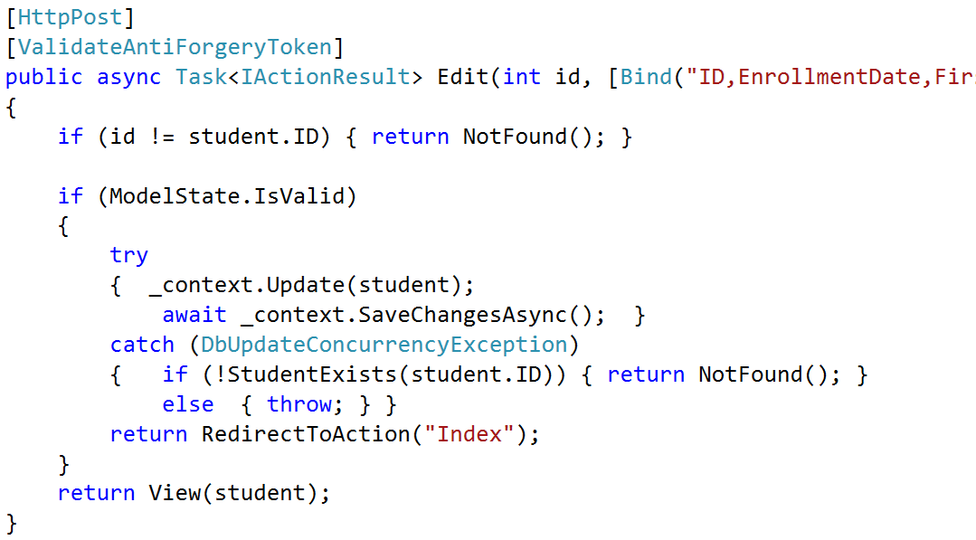
3B. Edit method (POSt)

Slide 29
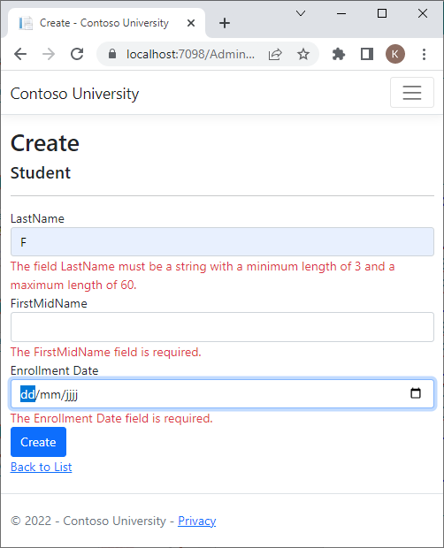
Validations (more to come later)
public class Student
{
public int ID { get; set; }
[StringLength(60, MinimumLength = 3)]
[Required]
public string LastName { get; set; }
[StringLength(60, MinimumLength = 3)]
[Required]
public string FirstMidName { get; set; }
[Display(Name = "Enrollment Date")]
[DataType(DataType.Date)]
public DateTime EnrollmentDate { get; set; }
public ICollection<Enrollment>? Enrollments { get; set; }
}

Slide 30
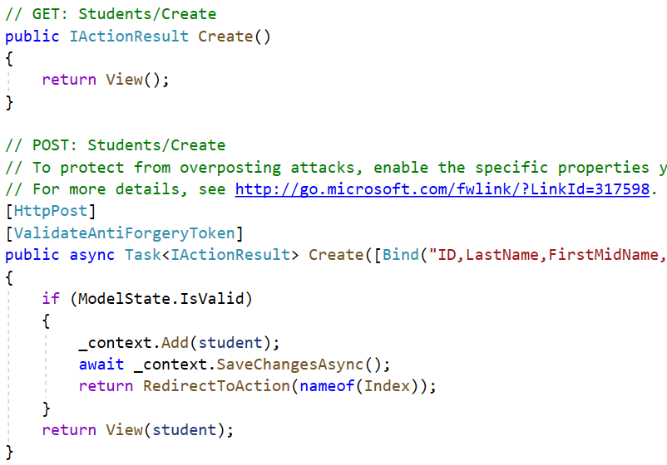
4. Create method

Slide 31
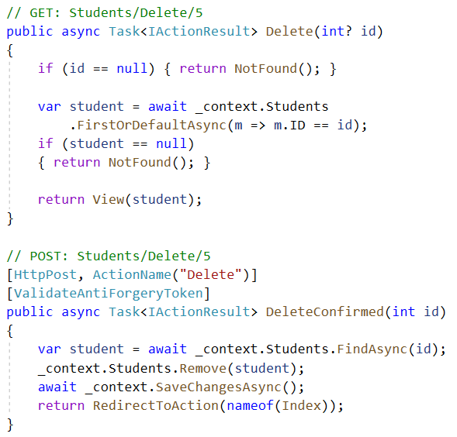
5.Delete method

Slide 32
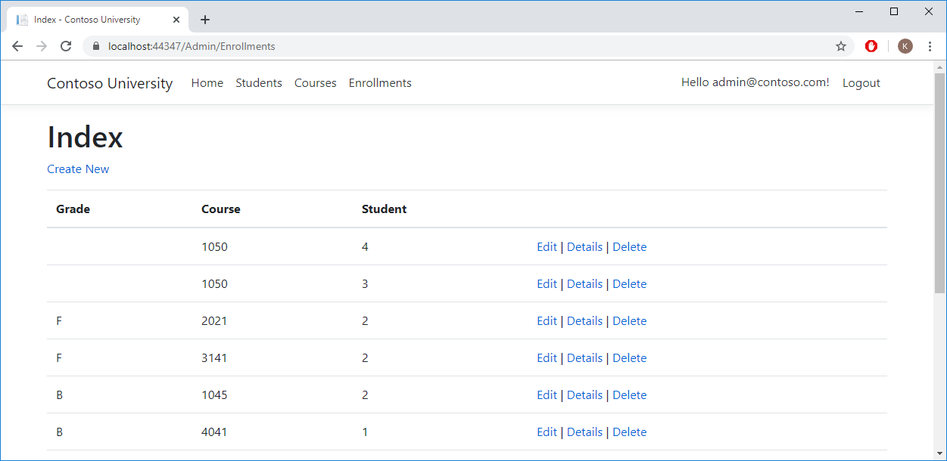
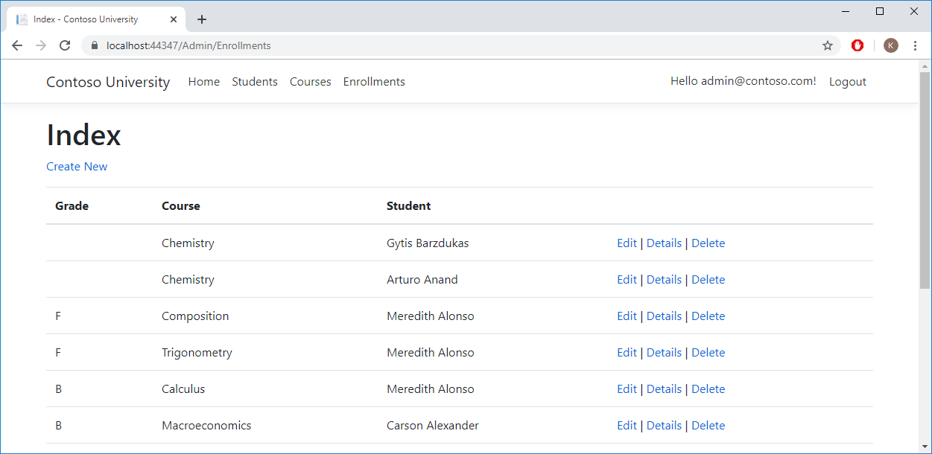
Relational data - Enrollments

Slide 33
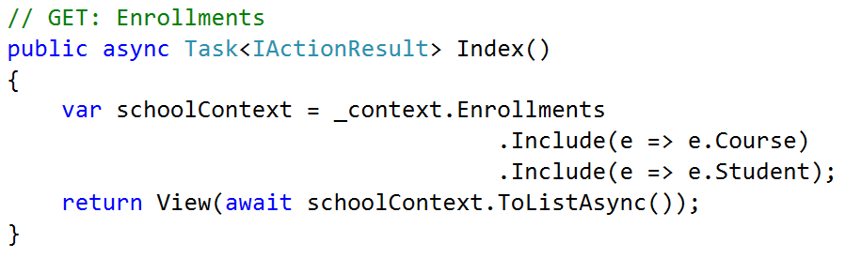
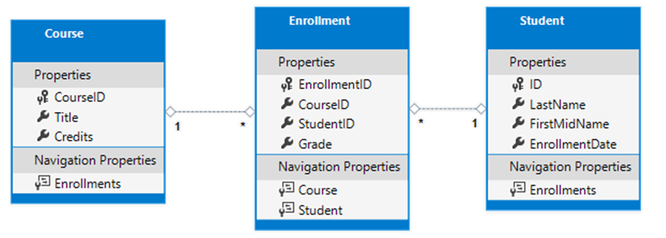
EnrollmentsController.cs (EAGER LOADING)

Slide 34
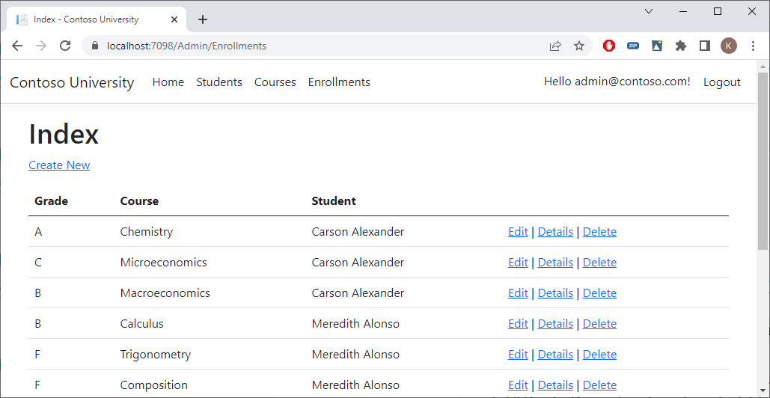
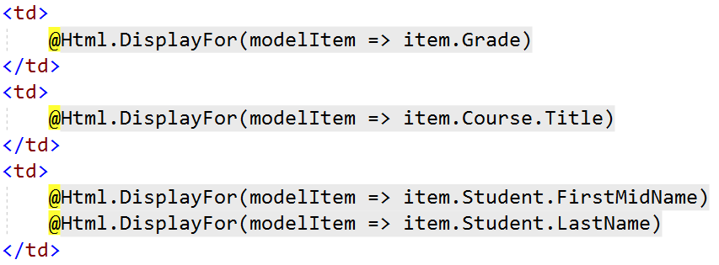
Index.cshtml

Slide 35
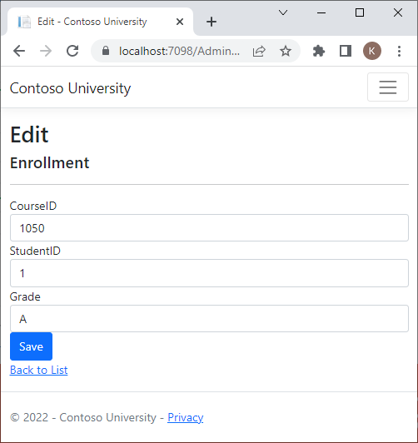
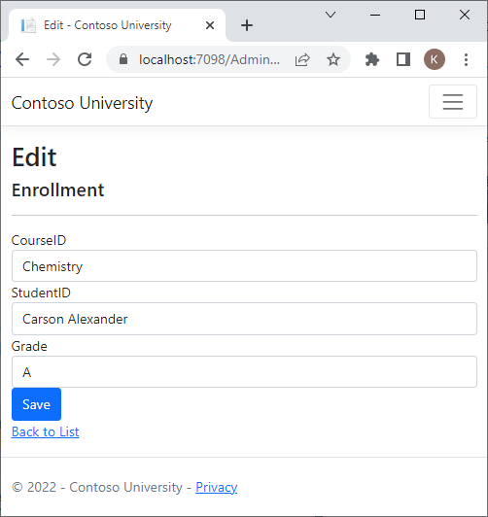
Edit Enrollment (also for create)

Slide 36
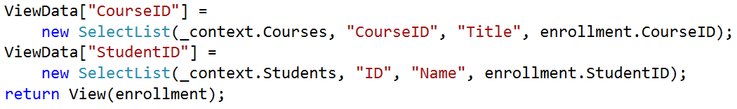
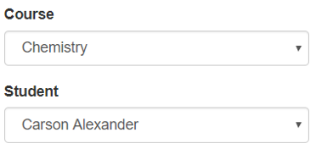
EnrollmentsController.cs (Edit)
2 (Get and Post) x for Edit, 2 x for Create (= 4)
"???"

Slide 37
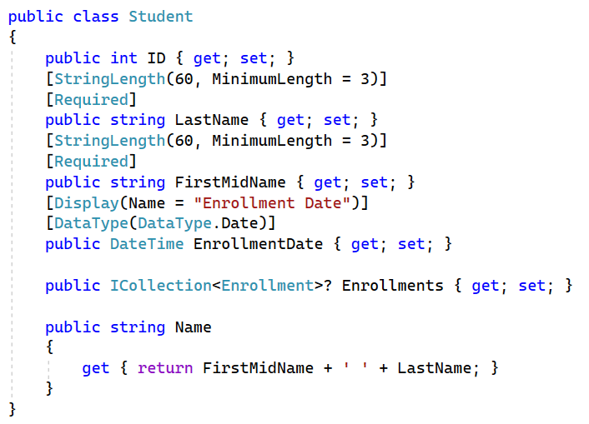
Student.cs

Slide 38
EnrollmentsController.cs (Edit)
2 (Get and Post) x for Edit, 2 x for Create (= 4)

Slide 39
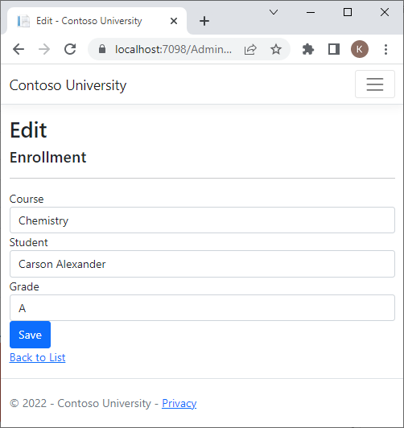
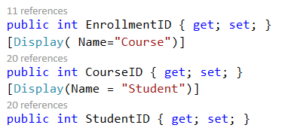
Edit.cshtml

Slide 40
Exercise
Music Store Part 2

